Slide 1


Introduction to Class Projects
One Health Summer Institute
Introduction to Data Analytics, Statistics & Programming in Epidemiologic Research
Dr. Ewy Mathé, Assistant Professor
Department of Biomedical Informatics
u.osu.edu/mathelab

Slide 2
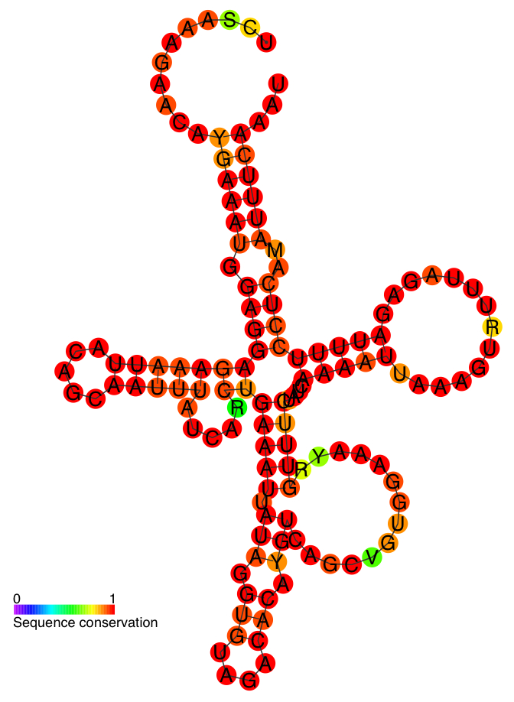
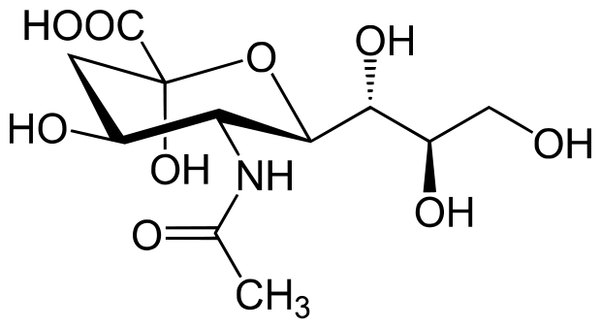

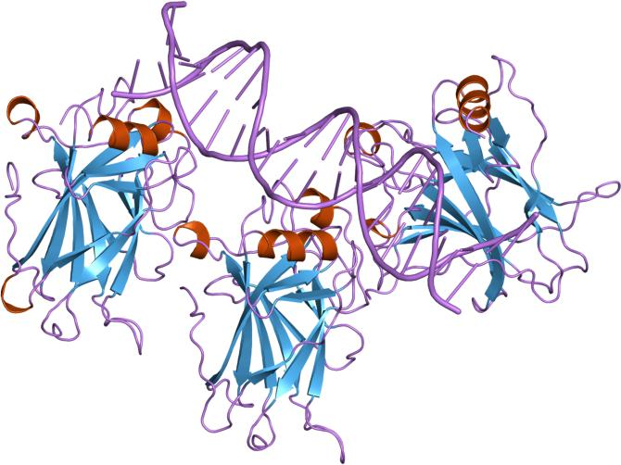
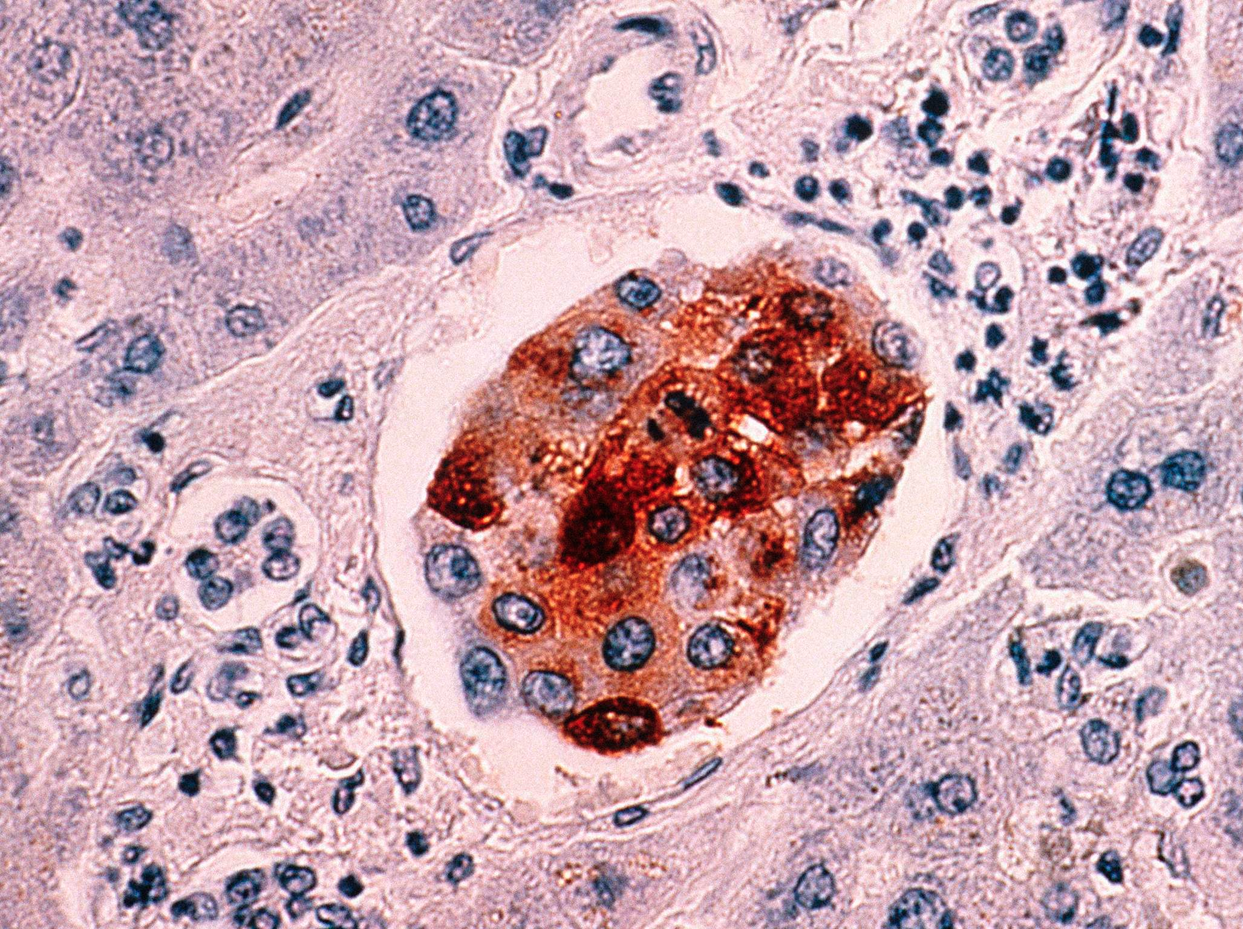
Molecular Biology Flow
Transcriptome
Exome
Metabolomics
DNA
RNA
Proteins
Metabolite
Phenotype
Environment
Genome
Epigenome
Proteome
protein interactions
Disease
Notes:
Let’s remind ourselves for one minute the information flow in the molecular biology dogma.
We start at the DNA level, and all sorts of information can be measured using genomics and epigenomics techniques. This DNA is transcribed to RNA and we can measure levels of RNA transcripts and assess variants. These transcripts get translated into proteins, which are involved in all sorts of cellular processes and create small molecules which are by-products of cellular metabolism. All of these characteristics define a very specific phenotype, such as a disease phenotype.
Now another component
I’ve just given you examples of two drugs that are particularly effective in patients either overexpressing a specific gene or harboring a specific mutation. How can we find more of these disease-specific states that could help guide our search for therapeutic targets?

Slide 3
NCI-60 cell lines
60 cancer cell lines used to test therapeutic compounds against.
Spans 9 different cancer types:
leukemia, melanoma, non-small cell lung, colon, brain, ovary, breast, prostate, and kidney
The project was started at the National Cancer Institute (Developmental Therapeutics program), and was fully functional in 1990.
Many different omics datasets have been collected in these cells, along with drug response data collected on
3,000 small molecules tested per year
Su et al. BMC Bioinformatics. 2009
Notes:
Let’s discuss correlation-based analyses, which will introduce also the NCI-60 cell line data, which is what we used initially to develop our method…
par(mfrow=c(1,2))
a<-1:10;b<-jitter(a,amount=20)
a<-c(a,100);b<-c(b,100)
pcc <- round(cor(a,b),2); pqc <- round(robcor(a,b,method='quadrant'),2)
plot(a,b,pch=16,main=paste0("Fake Data\nPCC=",pcc," PQC=",pqc), xlab="Metab1",ylab="Gene1")
abline(lm(b~a))
pcc <- round(cor(a[1:10],b[1:10]),2); pqc <- round(robcor(a[1:10],b[1:10],method='quadrant'),2)
plot(a[1:10],b[1:10],pch=16,main=paste0("Fake Data (No Outlier)\nPCC=",pcc," PQC=",pqc), xlab="Metab1",ylab="Gene1")

Slide 4
NCI-60 cell lines – metabolomic and transcriptomic data
NCI-60 cell lines: 57 cell lines with both metabolomics (Metabolon) and gene expression (Affy arrays)
342 metabolites and 19,961 genes
Su et al. BMC Bioinformatics. 2009
Notes:
Let’s discuss correlation-based analyses, which will introduce also the NCI-60 cell line data, which is what we used initially to develop our method…
par(mfrow=c(1,2))
a<-1:10;b<-jitter(a,amount=20)
a<-c(a,100);b<-c(b,100)
pcc <- round(cor(a,b),2); pqc <- round(robcor(a,b,method='quadrant'),2)
plot(a,b,pch=16,main=paste0("Fake Data\nPCC=",pcc," PQC=",pqc), xlab="Metab1",ylab="Gene1")
abline(lm(b~a))
pcc <- round(cor(a[1:10],b[1:10]),2); pqc <- round(robcor(a[1:10],b[1:10],method='quadrant'),2)
plot(a[1:10],b[1:10],pch=16,main=paste0("Fake Data (No Outlier)\nPCC=",pcc," PQC=",pqc), xlab="Metab1",ylab="Gene1")

Slide 5
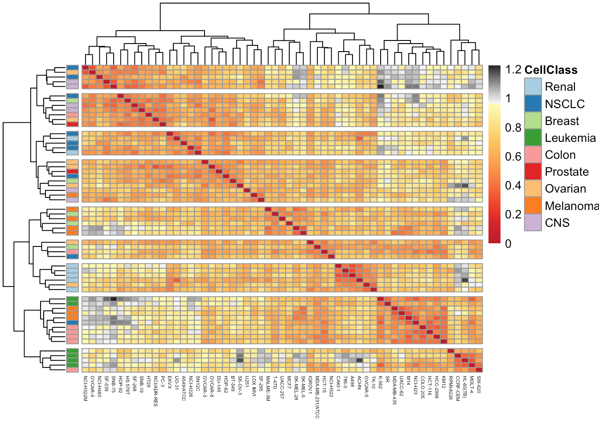
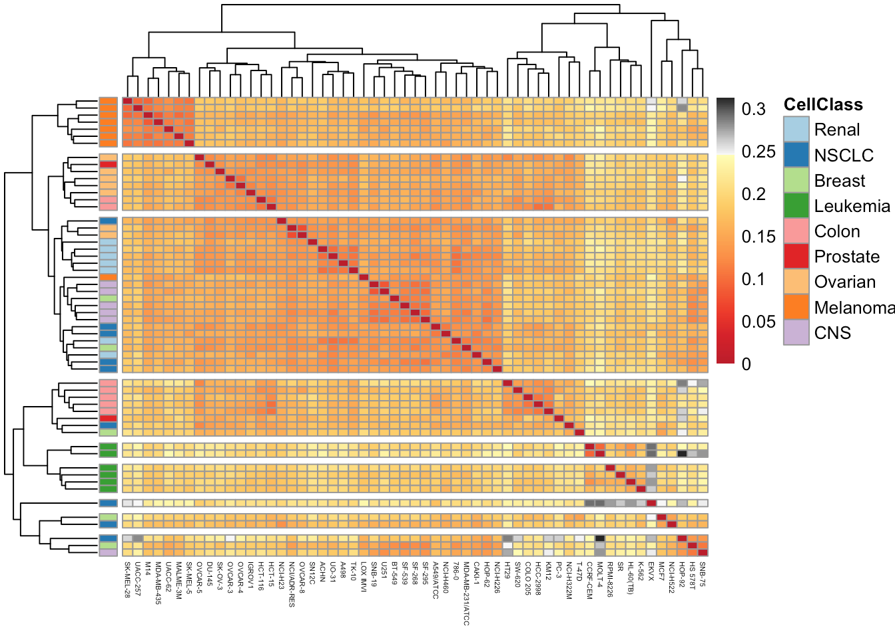
NCI-60 cell lines - metabolomic and transcriptomic data
NCI-60 cell lines: 57 cell lines with both metabolomics (Metabolon) and gene expression (Affy arrays)
342 metabolites and 19,961 genes
Metabolites
Genes
Su et al. BMC Bioinformatics. 2009
Notes:
Let’s discuss correlation-based analyses, which will introduce also the NCI-60 cell line data, which is what we used initially to develop our method…
par(mfrow=c(1,2))
a<-1:10;b<-jitter(a,amount=20)
a<-c(a,100);b<-c(b,100)
pcc <- round(cor(a,b),2); pqc <- round(robcor(a,b,method='quadrant'),2)
plot(a,b,pch=16,main=paste0("Fake Data\nPCC=",pcc," PQC=",pqc), xlab="Metab1",ylab="Gene1")
abline(lm(b~a))
pcc <- round(cor(a[1:10],b[1:10]),2); pqc <- round(robcor(a[1:10],b[1:10],method='quadrant'),2)
plot(a[1:10],b[1:10],pch=16,main=paste0("Fake Data (No Outlier)\nPCC=",pcc," PQC=",pqc), xlab="Metab1",ylab="Gene1")

Slide 6
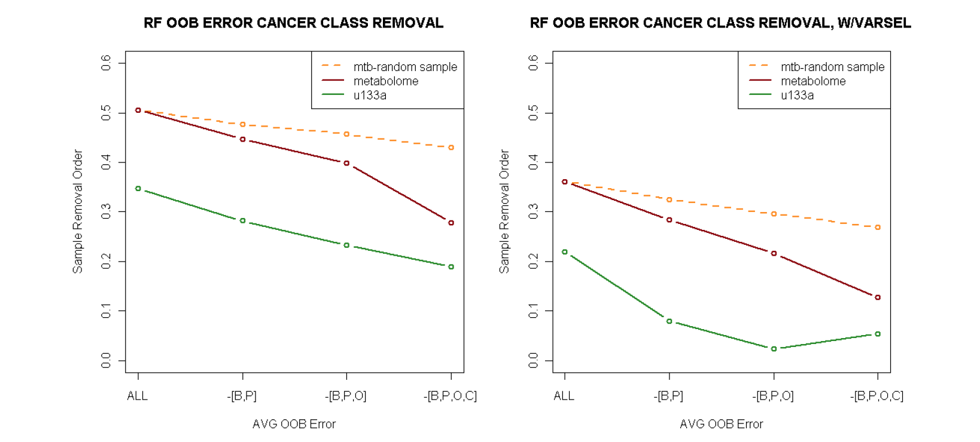
NCI-60 cell lines – main study findings
NCI-60 metabolome is noisier than transcriptome data (microarray).
Metabolome data does contain tissue specific signatures.
Su et al. BMC Bioinformatics. 2009
Notes:
Let’s discuss correlation-based analyses, which will introduce also the NCI-60 cell line data, which is what we used initially to develop our method…
par(mfrow=c(1,2))
a<-1:10;b<-jitter(a,amount=20)
a<-c(a,100);b<-c(b,100)
pcc <- round(cor(a,b),2); pqc <- round(robcor(a,b,method='quadrant'),2)
plot(a,b,pch=16,main=paste0("Fake Data\nPCC=",pcc," PQC=",pqc), xlab="Metab1",ylab="Gene1")
abline(lm(b~a))
pcc <- round(cor(a[1:10],b[1:10]),2); pqc <- round(robcor(a[1:10],b[1:10],method='quadrant'),2)
plot(a[1:10],b[1:10],pch=16,main=paste0("Fake Data (No Outlier)\nPCC=",pcc," PQC=",pqc), xlab="Metab1",ylab="Gene1")

Slide 7
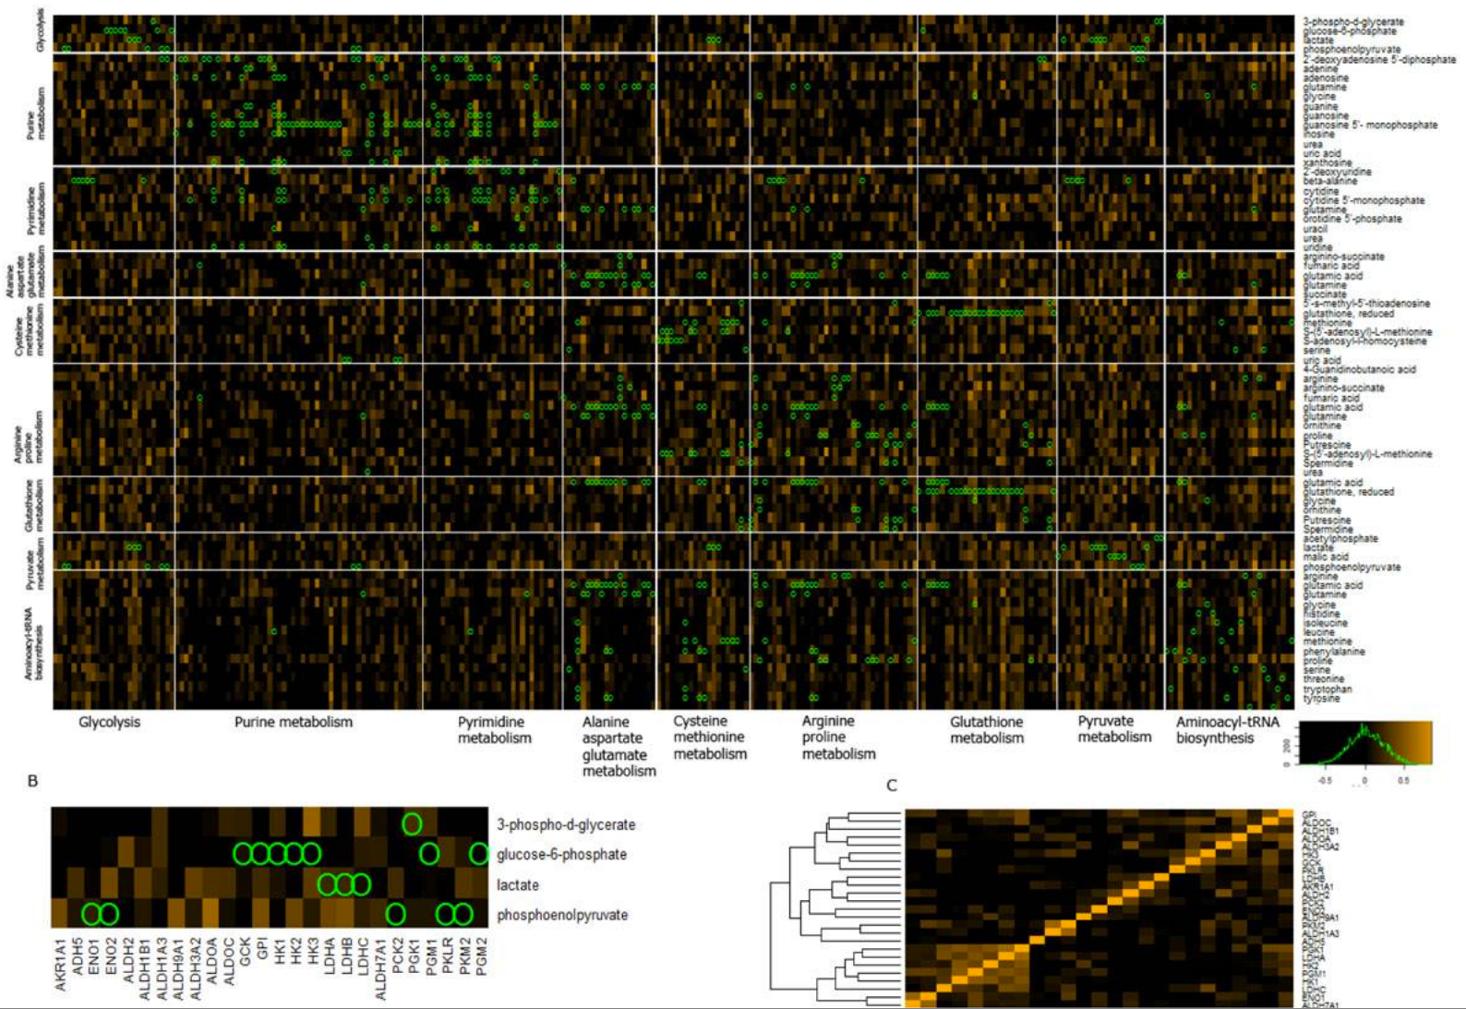
NCI-60 cell lines – main study findings
Su et al. BMC Bioinformatics. 2009
Notes:
Let’s discuss correlation-based analyses, which will introduce also the NCI-60 cell line data, which is what we used initially to develop our method…
par(mfrow=c(1,2))
a<-1:10;b<-jitter(a,amount=20)
a<-c(a,100);b<-c(b,100)
pcc <- round(cor(a,b),2); pqc <- round(robcor(a,b,method='quadrant'),2)
plot(a,b,pch=16,main=paste0("Fake Data\nPCC=",pcc," PQC=",pqc), xlab="Metab1",ylab="Gene1")
abline(lm(b~a))
pcc <- round(cor(a[1:10],b[1:10]),2); pqc <- round(robcor(a[1:10],b[1:10],method='quadrant'),2)
plot(a[1:10],b[1:10],pch=16,main=paste0("Fake Data (No Outlier)\nPCC=",pcc," PQC=",pqc), xlab="Metab1",ylab="Gene1")

Slide 8
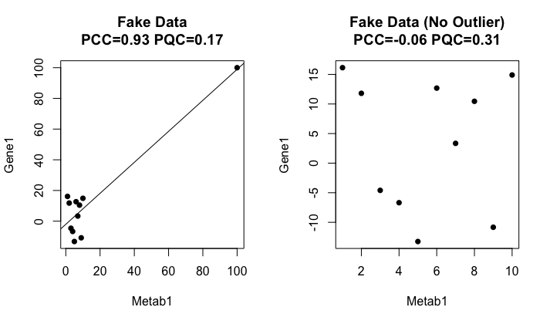
Correlation-based analyses
Combine Pearson’s Correlation coefficients (PCC) and Pairwise-quadrant Correlation Coefficients (PQC):
High PCC and high PQC → true correlation
High PCC and low PQC → outlier value
Su et al. BMC Bioinformatics. 2009
Notes:
Let’s discuss correlation-based analyses, which will introduce also the NCI-60 cell line data, which is what we used initially to develop our method…
par(mfrow=c(1,2))
a<-1:10;b<-jitter(a,amount=20)
a<-c(a,100);b<-c(b,100)
pcc <- round(cor(a,b),2); pqc <- round(robcor(a,b,method='quadrant'),2)
plot(a,b,pch=16,main=paste0("Fake Data\nPCC=",pcc," PQC=",pqc), xlab="Metab1",ylab="Gene1")
abline(lm(b~a))
pcc <- round(cor(a[1:10],b[1:10]),2); pqc <- round(robcor(a[1:10],b[1:10],method='quadrant'),2)
plot(a[1:10],b[1:10],pch=16,main=paste0("Fake Data (No Outlier)\nPCC=",pcc," PQC=",pqc), xlab="Metab1",ylab="Gene1")

Slide 9
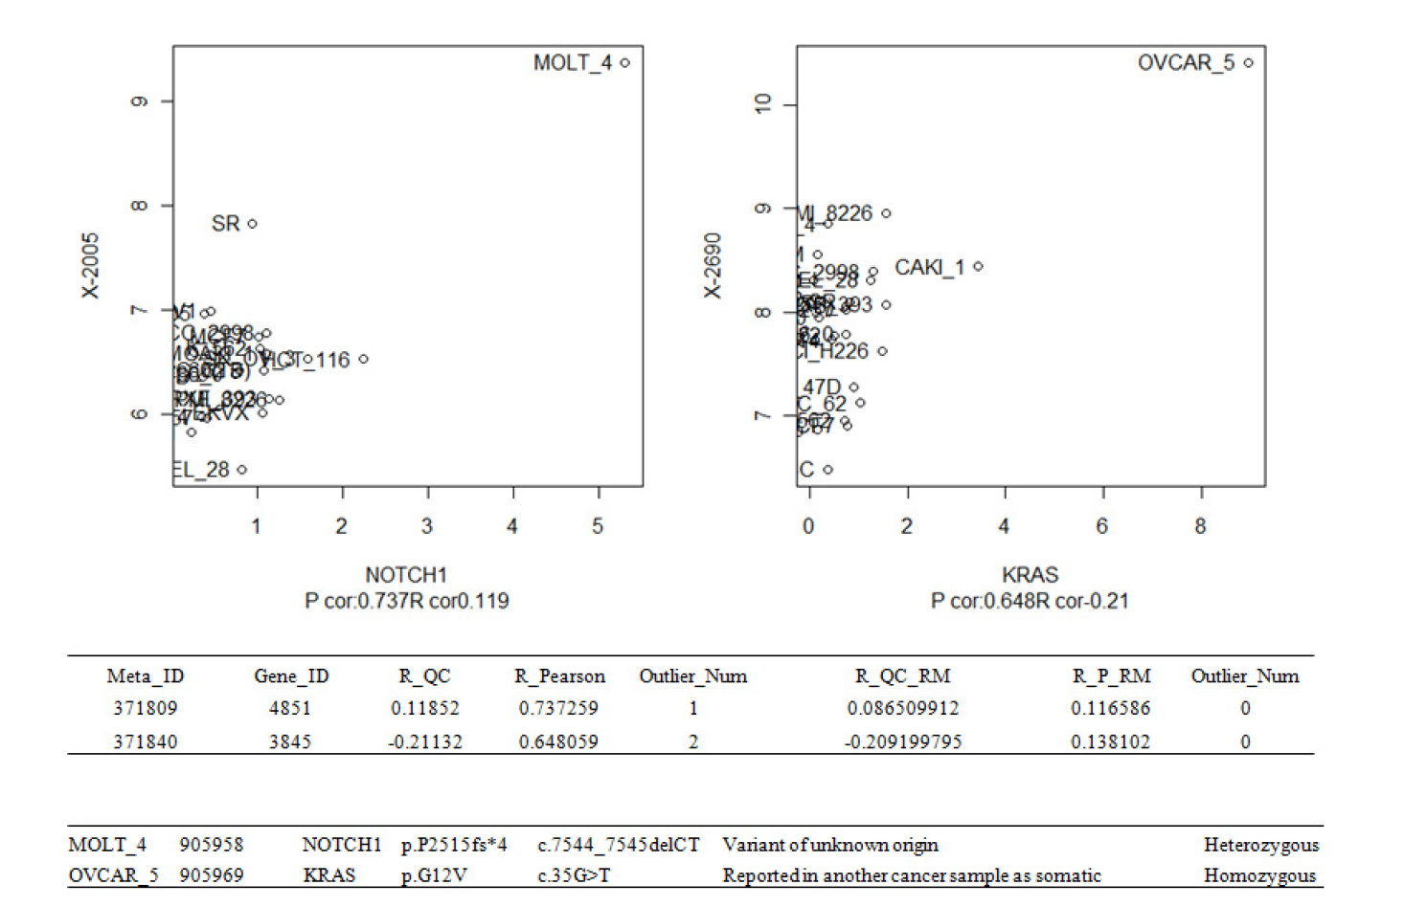
NCI-60 cell lines – main study findings
Gene-metabolite associations related to disease-related genomic modifications.
Su et al. BMC Bioinformatics. 2009
Notes:
Let’s discuss correlation-based analyses, which will introduce also the NCI-60 cell line data, which is what we used initially to develop our method…
par(mfrow=c(1,2))
a<-1:10;b<-jitter(a,amount=20)
a<-c(a,100);b<-c(b,100)
pcc <- round(cor(a,b),2); pqc <- round(robcor(a,b,method='quadrant'),2)
plot(a,b,pch=16,main=paste0("Fake Data\nPCC=",pcc," PQC=",pqc), xlab="Metab1",ylab="Gene1")
abline(lm(b~a))
pcc <- round(cor(a[1:10],b[1:10]),2); pqc <- round(robcor(a[1:10],b[1:10],method='quadrant'),2)
plot(a[1:10],b[1:10],pch=16,main=paste0("Fake Data (No Outlier)\nPCC=",pcc," PQC=",pqc), xlab="Metab1",ylab="Gene1")

Slide 10
Goals of Hands-On
Look at your data
Identify metabolites and/or genes that are altered in different cancer types
Look for correlations between genes and metabolites, and compare those between different cancer types
If time, also assess drug response
Notes:
Let’s discuss correlation-based analyses, which will introduce also the NCI-60 cell line data, which is what we used initially to develop our method…
par(mfrow=c(1,2))
a<-1:10;b<-jitter(a,amount=20)
a<-c(a,100);b<-c(b,100)
pcc <- round(cor(a,b),2); pqc <- round(robcor(a,b,method='quadrant'),2)
plot(a,b,pch=16,main=paste0("Fake Data\nPCC=",pcc," PQC=",pqc), xlab="Metab1",ylab="Gene1")
abline(lm(b~a))
pcc <- round(cor(a[1:10],b[1:10]),2); pqc <- round(robcor(a[1:10],b[1:10],method='quadrant'),2)
plot(a[1:10],b[1:10],pch=16,main=paste0("Fake Data (No Outlier)\nPCC=",pcc," PQC=",pqc), xlab="Metab1",ylab="Gene1")

Slide 11
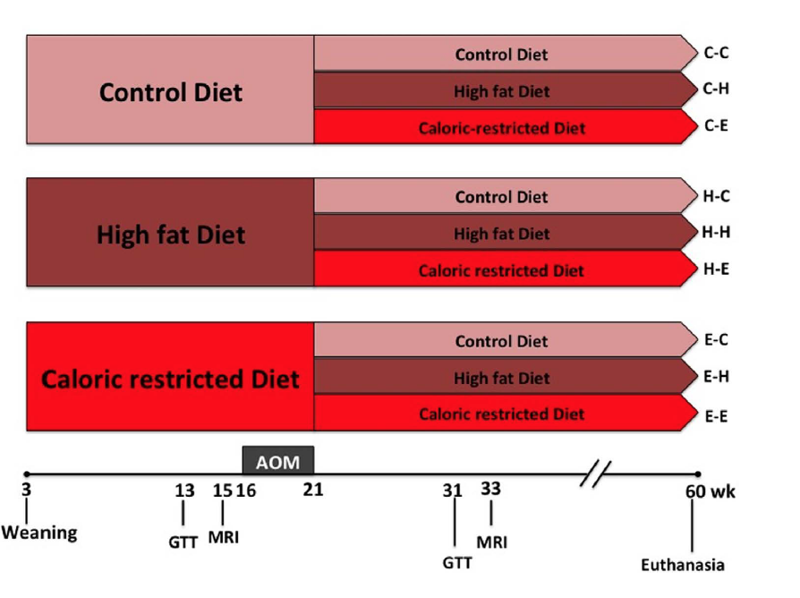
Lifetime Diet, the microbiome, and Colon Cancer
Murine model of lifetime obesity:
mice are fed 3 different diet types immediately after weaning, early in their development
High fat diet (mimics Western diet), control diet, and calorie-restricted diet
Colon cancer model: mice were injected with carcinogen (azoxymethane) to induce colon cancer
→ Very few mice developed colon cancer, but AOM induced aberrant crypt foci (ACF)
Xu et al. Science Reportts 2015
Notes:
Let’s discuss correlation-based analyses, which will introduce also the NCI-60 cell line data, which is what we used initially to develop our method…
par(mfrow=c(1,2))
a<-1:10;b<-jitter(a,amount=20)
a<-c(a,100);b<-c(b,100)
pcc <- round(cor(a,b),2); pqc <- round(robcor(a,b,method='quadrant'),2)
plot(a,b,pch=16,main=paste0("Fake Data\nPCC=",pcc," PQC=",pqc), xlab="Metab1",ylab="Gene1")
abline(lm(b~a))
pcc <- round(cor(a[1:10],b[1:10]),2); pqc <- round(robcor(a[1:10],b[1:10],method='quadrant'),2)
plot(a[1:10],b[1:10],pch=16,main=paste0("Fake Data (No Outlier)\nPCC=",pcc," PQC=",pqc), xlab="Metab1",ylab="Gene1")

Slide 12
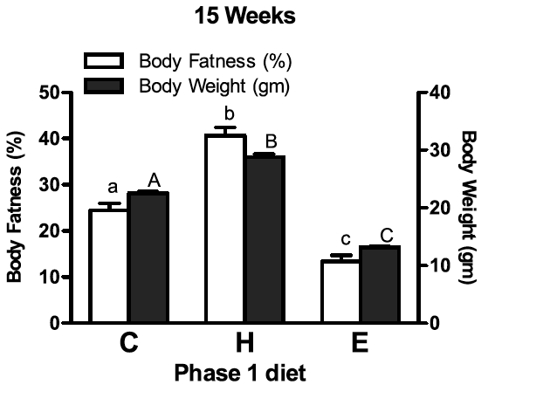
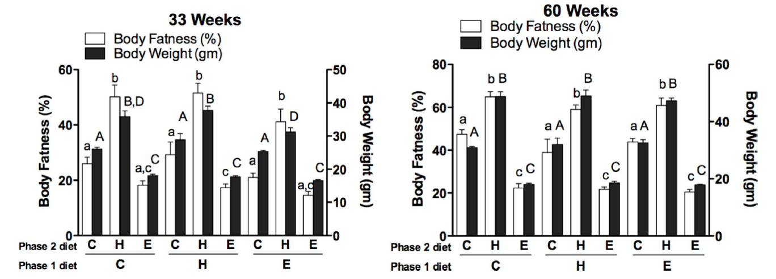
Effect of diet on obesity
Xu et al. Science Reportts 2015
Notes:
Two metrics were measured: body weight and body fatness. This experiment was performed to check that the diet was affecting the state of the obesity of the mice as expected.

Slide 13
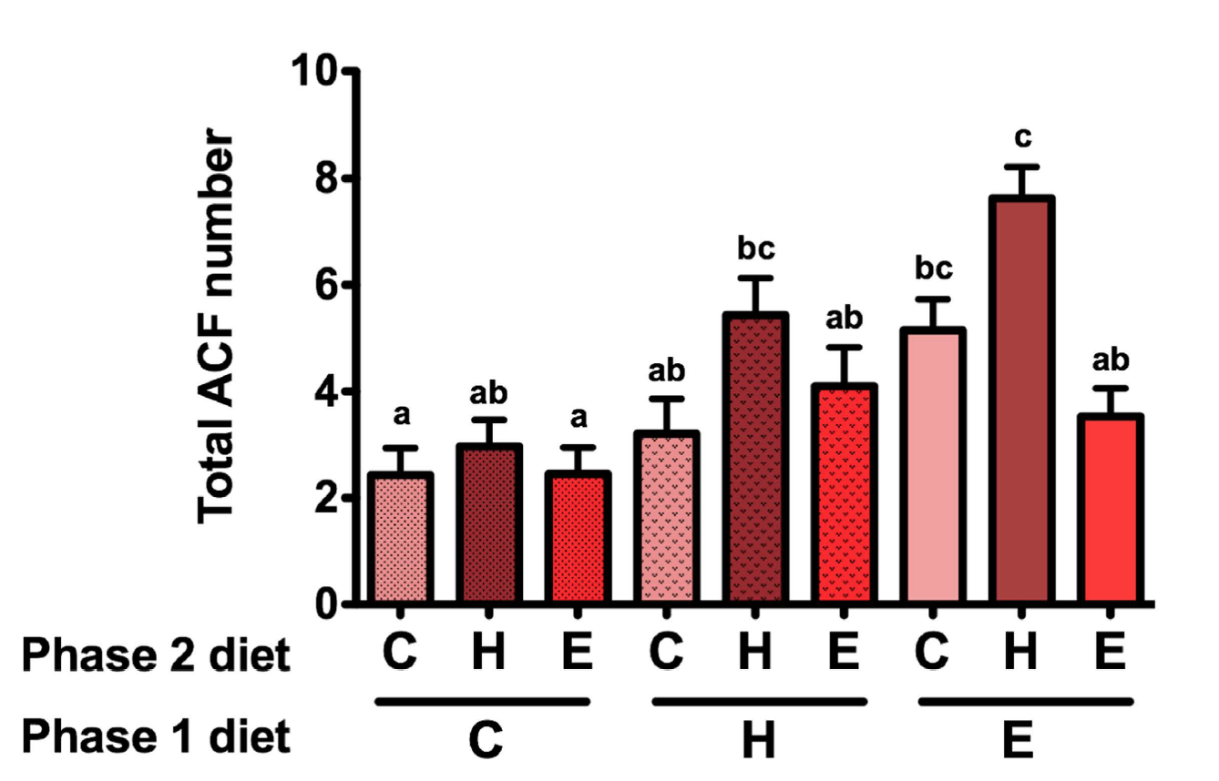
Effect of diet on aberrant crypt foci formation
Xu et al. Science Reportts 2015
Notes:
Two metrics were measured: body weight and body fatness. This experiment was performed to check that the diet was affecting the state of the obesity of the mice as expected.

Slide 14
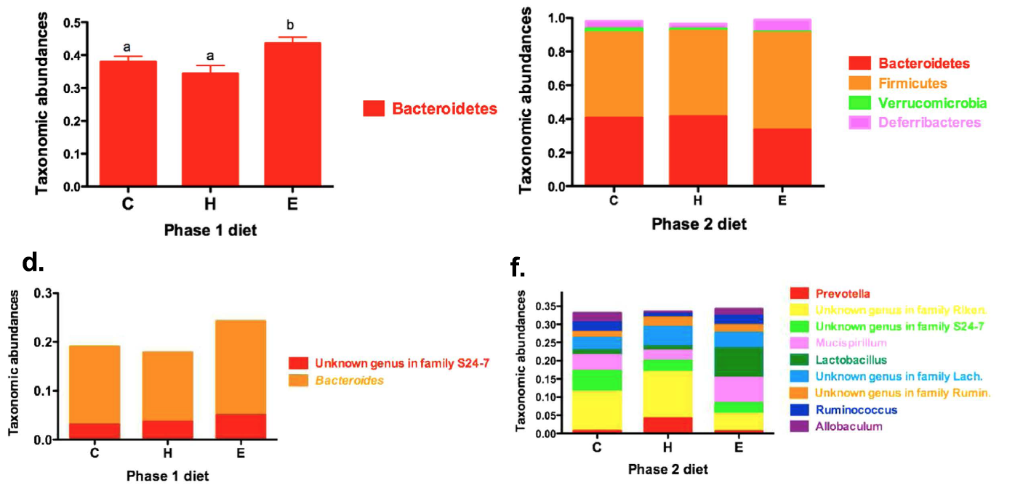
Effect of diet on the microbe environment of the colon
Phase 1
Phase 2
Phylum
Phylum
Genera
Genera
Xu et al. Science Reportts 2015
Notes:
These are showing statistically different microbes

Slide 15
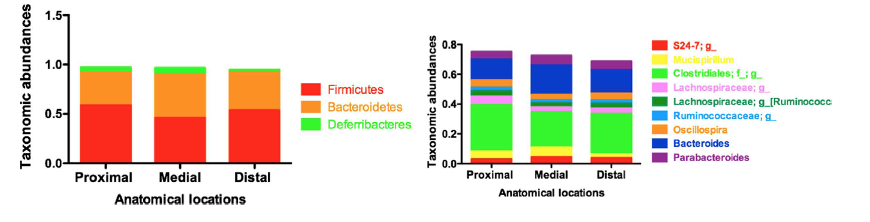
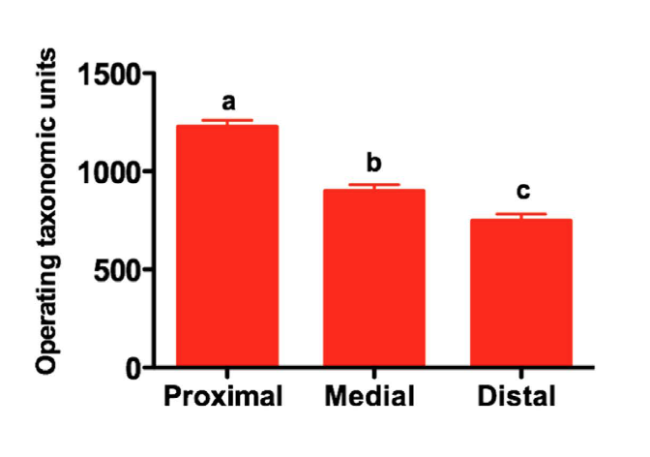
Microbe environment varies by colonic location
Phylum
Genera
Xu et al. Science Reportts 2015
Notes:
These are showing statistically different microbes

Slide 16
Evaluating associations of microbe proportions with ANOVA
In the Xu et al. manuscript, authors used ANOVA :
- took into account the fact that sample sizes are unbalanced
- adjustment for phase 1 diet, phase 2 diet, cohort, and colonic segment
In R, can us Poisson regression:
anova(glm( count ~ diet1 + diet2 + cohort + colonLoc + offset(coverage),
family = ”poisson”)
where count = count of reads and coverage = sequencing coverage

Slide 17
Evaluating associations of microbe proportions with beta regression
Used to model variables that assume values in the standard unit interval (0,1)
Assumption is that the dependent variable (e.g. outcome) is beta-distributed
The model takes into account heteroskedasticity (more variation in the data around the mean than at extremes) and skewness of the data, commonly seen in rates and proportions
In R:
betareg(proportions ~ diet1 + diet2 + cohort + colonLoc, link="logit")
Notes:
These are showing statistically different microbes

Slide 18
Goals of Hands-On
Look at your data
Identify differences in ACF by colonic location and/or diet
Identify differences microbe in colonic location and/or diet

